Slide 1
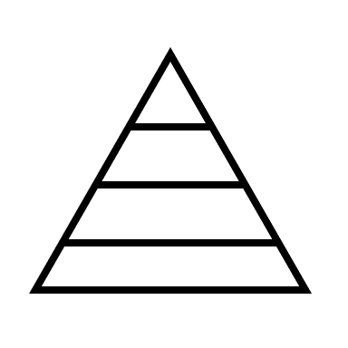
TOPDOWN APPOARCH
Understanding the Top-Down
Approach && How to apply it

Slide 2

WHAT IS TOPDOWN APPOARCH
WHAT : A method of analysis or decision-making that starts with the general or big picture and then moves to the specific or details.
Common in problem-solving, decision-making, and project management.
Often used in hierarchical structures where leaders establish direction and delegate tasks.

Slide 3
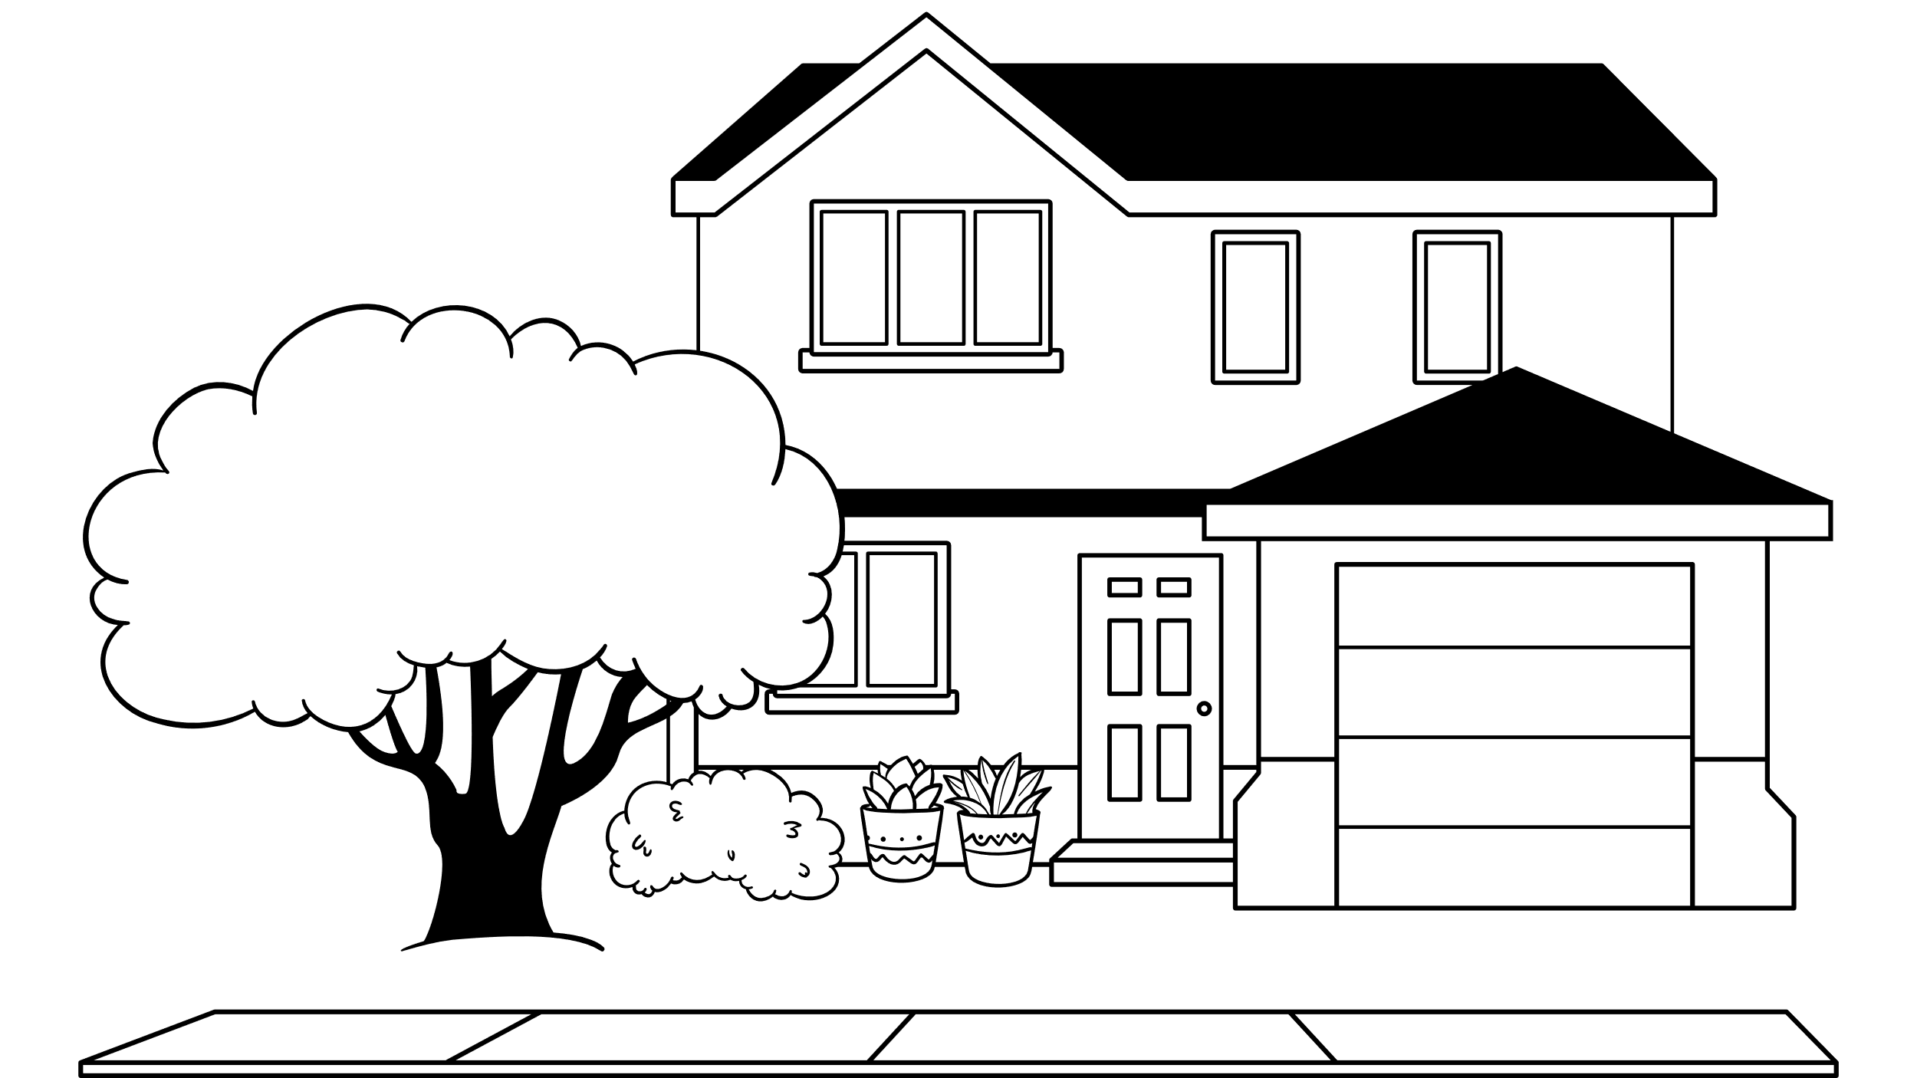
Example
Imagine you have a big, complex project in front of you, like building a house. The top-down approach is like starting at the roof and working your way down, floor by floor, wall by wall, until you reach the foundation. It's a method of problem-solving or decision-making that starts with the big picture and then breaks it down into smaller, more manageable pieces.

Slide 4
Pros & Cons
Pros
Cons
Clear goals & direction
Fast decisions & progress
Efficient resource allocation
Consistent outcomes
Demotivated employees
Stifled creativity & innovation
Poor adaptability
Communication issues

Slide 5
How to apply TOPDOWN APPOARCH
Break down the problem in these small steps :
Define the Big Picture :
Start with a clear vision and high-level goals for the project or organization.
Ensure everyone understands the overall roadmap and desired outcomes.
2. Break Down Goals :
Divide the main goal into smaller, achievable objectives and tasks.
Create a structure outlining how these parts fit together.
3. Delegate and Communicate :
Assign specific tasks and responsibilities to team members based on their expertise.
Communicate deadlines, expectations, and resources clearly and regularly.
4. Monitor and Adapt :
Track progress and identify any issues or deviations from the plan.
Be open to feedback and adjustments as needed, but maintain overall direction.
5. Encourage Feedback:
While maintaining central control, encourage input and suggestions from team members.
This can help refine the plan and prevent missed opportunities.

